Slide 1
Fully-Connected Tensor Network Decomposition and Its Application to
Higher-Order Tensor Completion
Yu Zhang 2021.04.05

Slide 2
目录
01
Introduction
CONTENT
Some background about TN decompositions.
02
FCTN Decomposition
The main idea of this paper——FCTN, as an extension of the TT and TR decomposition.
03
FCTN Decomposition-Based TC Method
Applying the FCTN Decomposition to tensor completion.
04
Numerical Experiments
In order to verify the FCTN-TC, the paper conducts synthetic data and real data experiments.
05
Summary
The summary of FCTN framework, including strength and future work.

Slide 3
01
Introduction
Some background about TN decompositions.

Slide 4
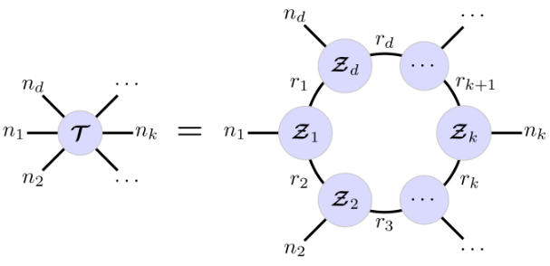
Introduction
Some background about TN decompositions
Tucker Decomposition
TN Decomposition
Tensor-train(TT) Decomposition
higher-order tensors
Tensor-ring(TR) Decomposition
CP/FCTN/… Decomposition

Slide 5
Introduction
Some background about TN decompositions
Limitations
* Only establish the correlations among two adjacent tensor rather than any two factors.
* It is not simple for TT/TR decomposition to keep invariance, which brings inflexibility(only reverse permuting).
Proposed FCTN, which breaks through the limitations of TT/TR decompositions.
Employ the FCTN decomposition to TC problem and develop an algorithm to solve it.
Demostrate the convergence of the developed algorithms.

Slide 6
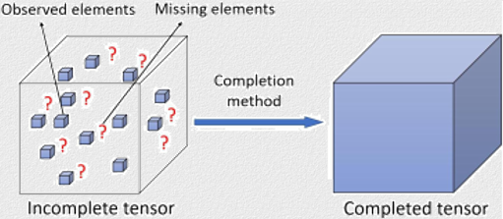
Introduction
Some background about TN decompositions
Tensor Completion
Missing Values Problems: recommender system design, image/video inpainting, and traffic data completion.
Tensor Completion (TC): complete a tensor from its partial observation.

Slide 7
02
FCTN Decomposition
The main idea of this paper——FCTN, as an extension of the TT and TR decomposition.

Slide 8
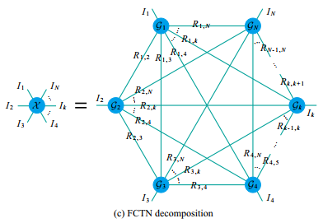
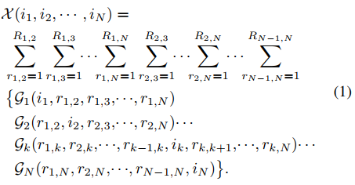
FCTN Decomposition
Basic defination
Definition 1 (Generalized Tensor Transposition)
Definition 3 (Tensor Contraction)
$${\overset{⃑}{𝒳}}^{n}∈ℝ^{I_{n_{1}}×I_{n_{2}}×…×I_{n_{N}}}$$
$$𝒵=𝒳×_{n_{1:d}}^{m_{1:d}}𝒴∈ℝ^{I_{n_{d+1}}×…×I_{n_{N}}×J_{m_{d+1}}×…{×J}_{m_{N}}}$$
$${\overset{⃑}{𝒳}}^{n}=permute(𝒳,n)$$
$$𝒳=ipermute({\overset{⃑}{𝒳}}^{n},n)$$
$$Z_{\left[1:N−d;N−d+1:N+M−2d\right]}=X_{[n_{d+1:N};n_{1:d}]}Y_{[m_{1:d};m_{d+1:M}]}$$
$$⇔$$
Definition 2 (Generalized Tensor Unfolding)
Definition 4 (FCTN Decomposition)
$$X_{\left[n_{1:d};n_{d+1:N}\right]}=reshape({\overset{⃑}{𝒳}}^{n},\prod_{i=1}^{d}{I_{n_{i}}},\prod_{i=d+1}^{N}{I_{n_{i}}})$$
$$X_{\left[n_{1:d};n_{d+1:N}\right]}=GenUnfold({\overset{⃑}{𝒳}}^{n},n_{1:d},n_{d+1:N})$$
$$𝒳=Genfold(X_{\left[n_{1:d};n_{d+1:N}\right]},n_{1:d},n_{d+1:N})$$
$X_{(k)}$ ?
$$𝒳=FCTN\left({\left\{𝒢_{K}\right\}}_{k=1}^{N}\right)=FCTN(𝒢_{1},𝒢_{2},…,𝒢_{n})$$
FCTN-ranks: $R_{k_{1},k_{2}}$
intrinsic correlations and converts

Slide 9
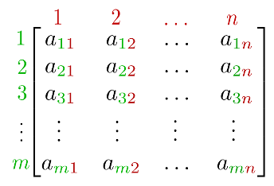
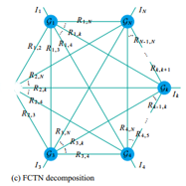
FCTN Decomposition
Basic Theorem
Transpositional Invariance
Rank Relation
$$Rank(X_{[n_{1:d};n_{d+1:N}]})≤\prod_{i=1}^{d}{\prod_{j=d+1}^{N}{R_{n_{i},n_{j}}}}$$
$$𝒳=FCTN(𝒢_{1},𝒢_{2},…,𝒢_{n})$$
After reordering of the vector(1,2,…N)
storage cost
Parameters
FCTN: $O(NIR_{1}^{N−1})$
Tucker: $O\left(NIR_{2}+R_{2}^{N}\right)$
$${\overset{⃑}{𝒳}}^{n}=FCTN(\overset{⃑}{{𝒢_{1}}_{n_{1}}^{n}},\overset{⃑}{{𝒢_{2}}_{n_{2}}^{n}},…,\overset{⃑}{{𝒢_{1}}_{n_{N}}^{n}})$$
$$r\left(A\right)≤\min\left(m,n\right)≤m,n$$
FCTN essentially invariable
FCTN Composition
$$𝒳=FCTN\left({\left\{𝒢_{K}\right\}}_{k=1}^{N}\right)$$
$$M_{(t)}=FCTN\left({\left\{𝒢_{K}\right\}}_{k=1}^{N}, /𝒢_{t}\right)$$
$$M_{(t)}=$$
$$X_{(t)}={(G_{t})}_{(t)}{(M_{t})}_{[m_{1:N−1};n_{1:N−1}]}$$
Compute one needs to fix the others
Supplementary Material

Slide 10
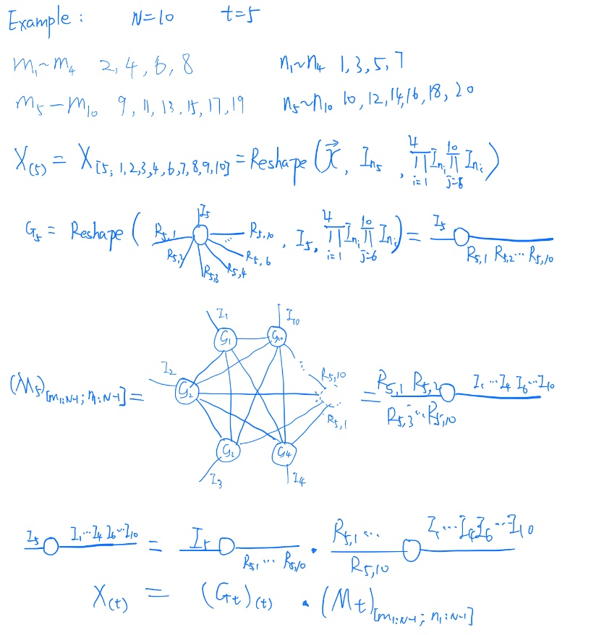
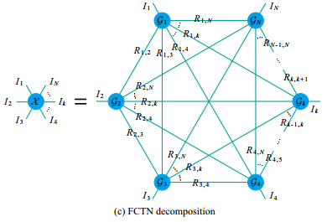
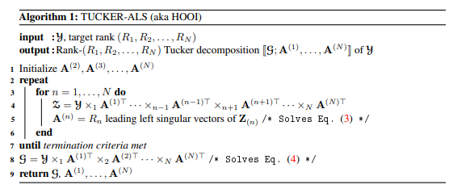
FCTN Decomposition
$$X_{(t)}={(G_{t})}_{(t)}{(M_{t})}_{[m_{1:N−1};n_{1:N−1}]}$$
Parameters analysis
FCTN-Decomposition
$$O(NIR_{1}^{N−1})$$
Tucker-Decomposition
$$O(NIR_{2}+R_{2}^{N})$$

Slide 11
03
FCTN Decomposition-Based TC Method
Applying the FCTN Decomposition to tensor completion.

Slide 12
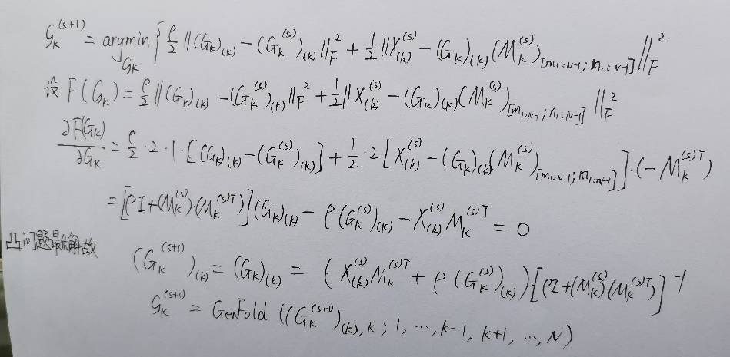
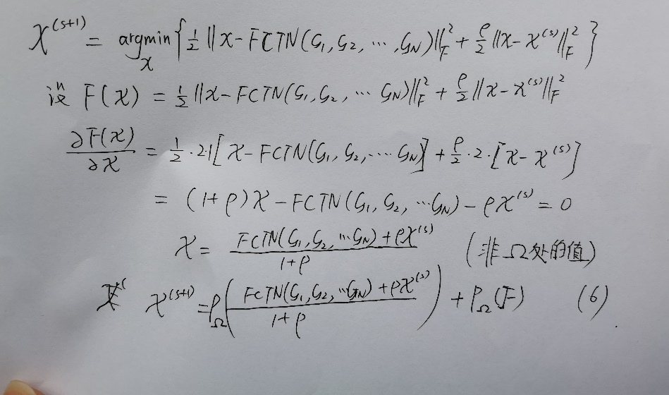
FCTN Decomposition-Based TC Method
Model and Solving Algorithm
FCTN-TC model can be formulated as
$$𝒢_{k}$$
$P_{Ω}$ is a projection operator. Employ the framework of proximal alternating minimization (PAM), the solution can be obtained by alternately updating.
$$𝒳$$
$f\left(𝒢,𝒳\right)$ is the objective function of (2)
MP 10.1007/s10107-011-0484-9(2011)

Slide 13
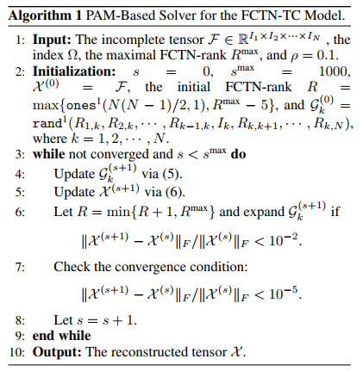
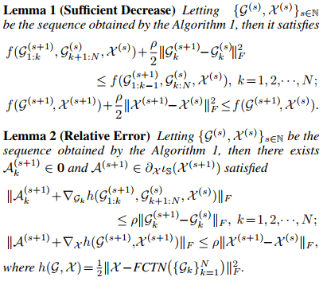
FCTN Decomposition-Based TC Method
Model and Solving Algorithm
Computational Complexity Analysis
The computational cost lies on two part:
Updating $𝒢_{k}$: $O(N\sum_{k=2}^{N}{I^{k}R^{k\left(N−k\right)+k−1}}+NI^{N−1}R^{2\left(N−1\right)}+NR^{3(N−1)})$
Updating $𝒳$: $O(N\sum_{k=2}^{N}{I^{k}R^{k\left(N−k\right)+k−1}})$
The whole computational complexity at each iteration
$$O(N\sum_{k=2}^{N}{I^{k}R^{k\left(N−k\right)+k−1}}+NI^{N−1}R^{2\left(N−1\right)}+NR^{3(N−1)})$$
Convergence Analysis
What happens if the $ℱ$ is complete ?

Slide 14
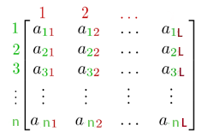
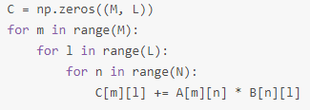
FCTN Decomposition-Based TC Method
Computational Complexity Analysis
Matrix(2-order tensor) dot product
3-order tensor contraction
M
P
L
L
N
Q
The computational complexity of$A_{MNL}B_{LPQ}$?
$$O(MNLPQ)$$
$$M∗N$$
$$N∗L$$
The computational complexity of$A_{MN}B_{NL}$？
$$O(MNL)$$
The computational complexity of$A_{MNL}B_{NLQ}$ ？
Any regular ?

Slide 15
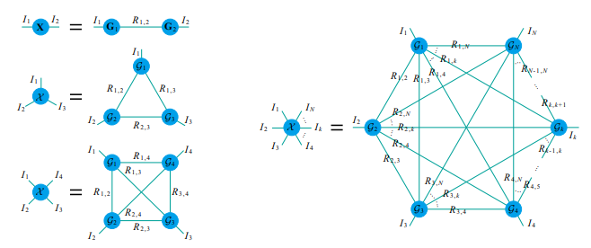
FCTN Decomposition-Based TC Method
Expansion
Computational Complexity Analysis
$$R_{1,2}$$
$$R_{1,2}$$
$$I$$
…
$$I$$
…
…
…
2组R
$$R_{1,N}$$
$$R_{1,N}$$
$$I^{2}R^{2\left(N−2\right)+2−1}$$
$$R_{1,2}$$
…
$$R_{1,N}$$
…
$$R_{3,1}$$
$$R_{2,3}$$
$$R_{3,k−1}$$
$$I$$
$$I$$
…
…
$$R_{3,k+1}$$
…
…
$$I$$
$$R_{3,N}$$
$$R_{2,N}$$
3组R
$$I^{3}R^{3\left(N−3\right)+3−1}$$
eg:
$$I_{2}$$
$$R_{1,2}$$
$$R_{1,3}$$
$$I_{2}$$
$$I_{1}$$
$$R_{1,3}$$
$$O(I_{1}I_{2}I_{3}R_{2,3}R_{1,3})$$
$$I_{1}$$
$$R_{1,2}$$
$$O(I_{1}I_{2}R_{1,2}R_{2,3}R_{1,3})$$
$$R_{1,3}$$
$$I_{3}$$
$$R_{2,3}$$
$$R_{1,3}$$
$$I_{2}$$
$$I_{3}$$
$$R_{2,3}$$
$$R_{2,3}$$
$$I_{3}$$
$$I_{1}$$
$$R_{2,3}$$
$\sum_{k=2}^{3}{I^{k}R^{k\left(3−k\right)+k−1}}$= $I^{2}R^{3}$+ $I^{3}R^{2}$

Slide 16
FCTN Decomposition-Based TC Method
Computational Complexity Analysis
$$G_{k}^{(s+1)}$$
$$𝒳^{(s+1)}$$
$${(G_{k}^{(s+1)})}_{(k)}=$$
$$\left[X_{\left(k\right)}^{\left(s\right)}{{(M}_{k}^{(s)})}_{[m_{1:N−1};n_{1:N−1}]}+ρ{(G_{k}^{(s)})}_{(k)}\right]$$
$${\left[{\left(M_{k}^{\left(s\right)}\right)}_{\left[m_{1:N−1};n_{1:N−1}\right]}{\left(M_{k}^{\left(s\right)}\right)}_{\left[n_{1:N−1};m_{1:N−1}\right]}+ρI\right]}^{−1}$$
$𝒳^{(s+1)}=𝒫_{Ω}\left(\frac{FCTN\left({\left\{𝒢_{k}^{(s+1)}\right\}}_{k=1}^{N}\right)+ρ𝒳^{(s)}}{1+ρ}\right)+$ $𝒫_{Ω}(ℱ)$
Updating $𝒢_{k}$
Updating $𝒳$
$$O(N\sum_{k=2}^{N}{I^{k}R^{k\left(N−k\right)+k−1}}+N I^{N−1}R^{2\left(N−1\right)}+N{ R}^{3(N−1)})$$
$$O(\sum_{k=2}^{N}{I^{k}R^{k\left(N−k\right)+k−1}})$$
Complexity of matrix inverse
The rest leg of k group
Complexity of matrix inverse
K groups are all missing the legs to be contracted
$${\left[{\left(M_{k}^{\left(s\right)}\right)}_{\left[m_{1:N−1};n_{1:N−1}\right]}{\left(M_{k}^{\left(s\right)}\right)}_{\left[n_{1:N−1};m_{1:N−1}\right]}+ρI\right]}^{−1}$$

Slide 17
04
Numerical Experiments
In order to verify the FCTN-TC, the paper conducts synthetic data and real data experiments.

Slide 18
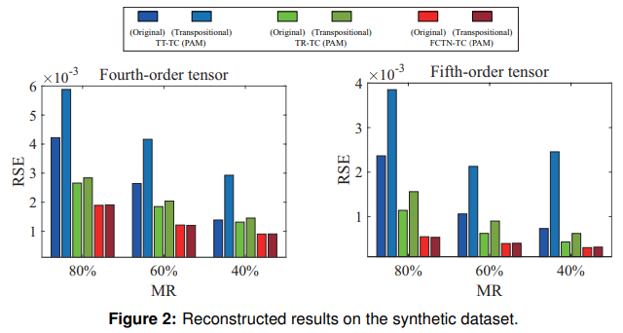
Numerical Experiments
Synthetic Data Experiments
MR(missing ratio)
Compared Methods: TT-TC (PAM), TR-TC (PAM), and FCTN-TC (PAM);
Quantitative Metric: the relative error (RSE) between the reconstructed tensor and the ground truth.
Two permutations
Fourth-order tensor: original(1,2,3,4) and generalized transposition(2,4,1,3)
Fifth-order tensor: original(1,2,3,4) and generalized transposition(2,4,1,3,5)

Slide 19
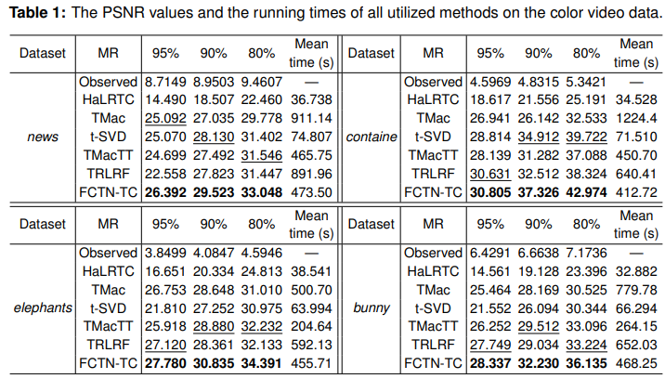
Numerical Experiments
Color Video Data
Compared Methods
HaLRTC [Liu et al. 2013; IEEE TPAMI ];
TMac [Xu et al. 2015; IPI ];
t-SVD [Zhang and Aeron 2017; IEEE TSP];
TMacTT [Bengua et al. 2017; IEEE TIP];
TRLRF [Yuan et al. 2019; AAAI ].
Quantitative Metric
PSNR
RSE
Dataset
color videos (CVs)
hyperspectral video (HSV)

Slide 20
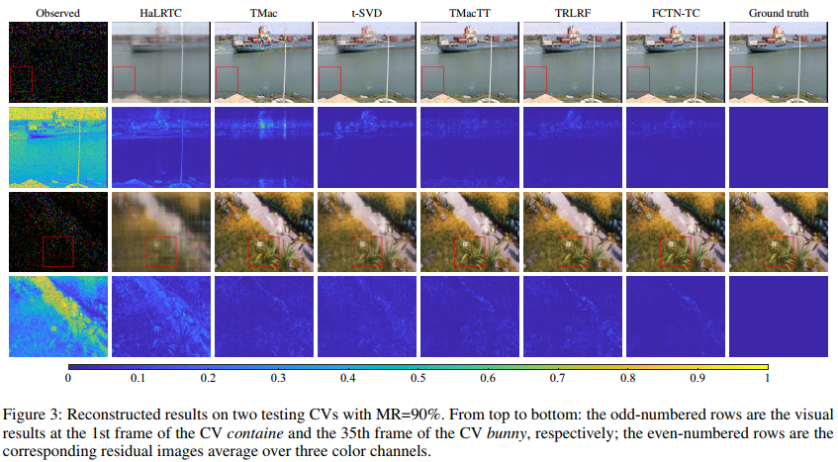
Numerical Experiments
Color Video Data
residual images: the absolute difference between the reconstructed image and the ground truth.

Slide 21
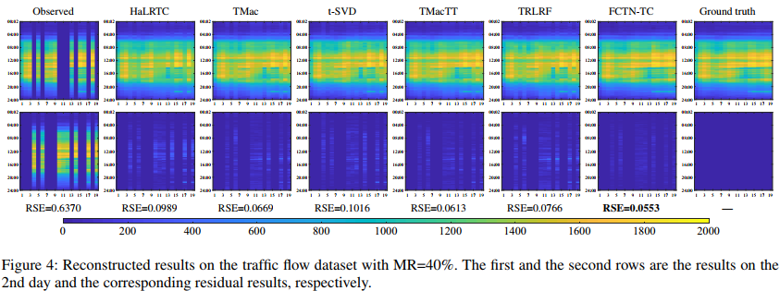
Numerical Experiments
Traffic Data
30×24×31×19 (minute×hour×day×segment)

Slide 22
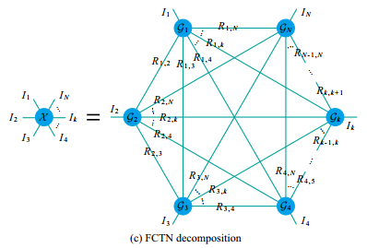
Summary
Reorganize the thoughts of the article
Conclusion
Proposed FCTN decomposition and its strength——transpositional invariable and characterize the correlations between any two modes of tensors.
An FCTN-TC model was proposed with an efficient PAM-based solver.
Analysis the computational complexity of FCTN-TC.
Experimental results demonstrated its superior on the slice missing problem.
Future work
How to find the optimal FCTN-ranks?
The application of FCTN.
The next/further episode…
Code/$R^{max}$-5/PAM/Theorem Proof

Slide 23
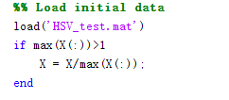
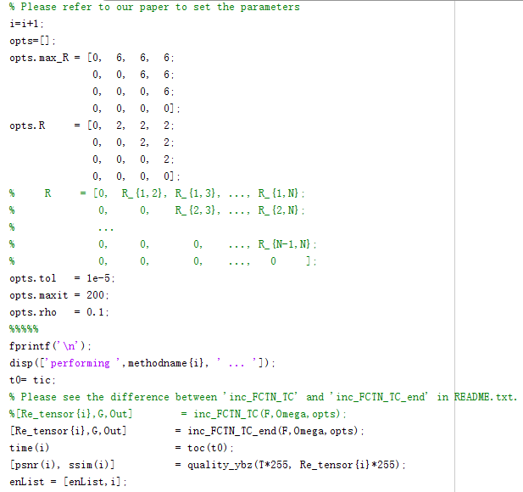
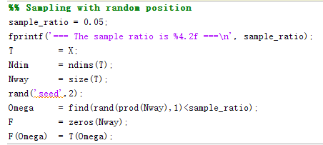
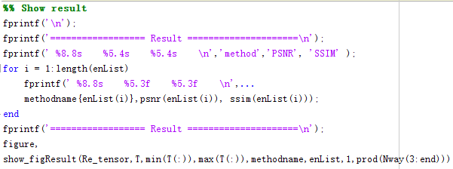
│ Demo_HSV.m
│ README.txt
├─data
│ HSV_test.mat
│
└─lib
│ show_figResult.m
│
├─inc_FCTN_TC
│ inc_FCTN_TC.m
│ inc_FCTN_TC_end.m
│ my_Fold.m
│ my_Unfold.m
│ tensor_contraction.m
│ tnprod_new.m
│ tnprod_rest.m
│ tnprod_rest_new.m
│ tnreshape_new.m
│
├─quality_assess
│ psnr_index.m
│ psnr_ybz.m
│ quality_ybz.m
│ ssim_index.m
│
└─tensor_toolbox
Contents.m
tenones.m
tenrand.m
tnorm.m
tt_cp_fg.m
Code
Demo_HSV.m
Load initial data
HSV_test.mat
X(60×60×20×20)
Sampling with random position
the index Ω
Perform algorithms
Show result
72105/1440000
PS： matlab find: Find indices and values of nonzero elements
Notes:
目录结构和代码一些细节可能稍微有一些出入，主要讲函数功能和接口

Slide 24
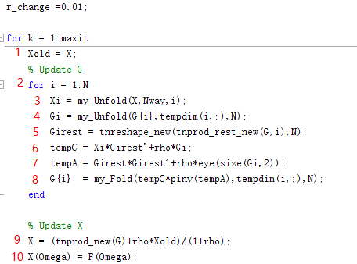
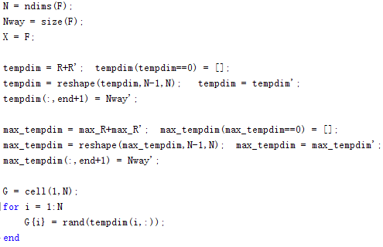
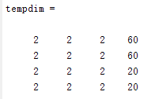
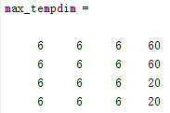
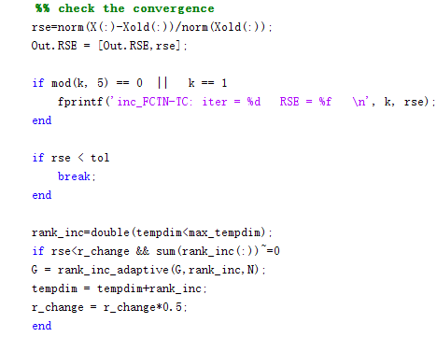
│ Demo_HSV.m
│ README.txt
├─data
│ HSV_test.mat
│
└─lib
│ show_figResult.m
│
├─inc_FCTN_TC
│ inc_FCTN_TC.m
│ inc_FCTN_TC_end.m
│ my_Fold.m
│ my_Unfold.m
│ tensor_contraction.m
│ tnprod_new.m
│ tnprod_rest.m
│ tnprod_rest_new.m
│ tnreshape_new.m
│
├─quality_assess
│ psnr_index.m
│ psnr_ybz.m
│ quality_ybz.m
│ ssim_index.m
│
└─tensor_toolbox
Contents.m
tenones.m
tenrand.m
tnorm.m
tt_cp_fg.m
Code
inc_FCTN_TC_end.m
N in experiment?

Slide 25
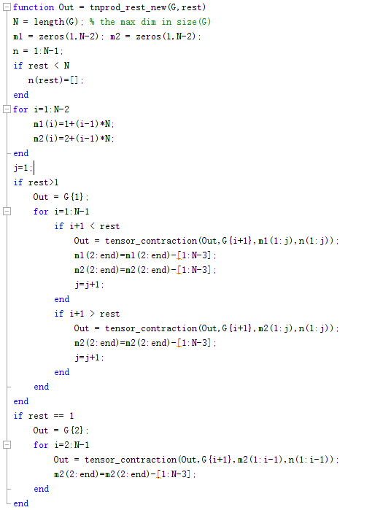
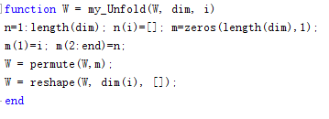
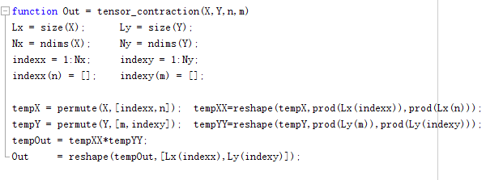
│ Demo_HSV.m
│ README.txt
├─data
│ HSV_test.mat
│
└─lib
│ show_figResult.m
│
├─inc_FCTN_TC
│ inc_FCTN_TC.m
│ inc_FCTN_TC_end.m
│ my_Fold.m
│ my_Unfold.m
│ tensor_contraction.m
│ tnprod_new.m
│ tnprod_rest.m
│ tnprod_rest_new.m
│ tnreshape_new.m
│
├─quality_assess
│ psnr_index.m
│ psnr_ybz.m
│ quality_ybz.m
│ ssim_index.m
│
└─tensor_toolbox
Contents.m
tenones.m
tenrand.m
tnorm.m
tt_cp_fg.m
Code
my_Fold.m
tnprod_rest_new.m
my_Unfold.m
tensor_contraction.m

Slide 26
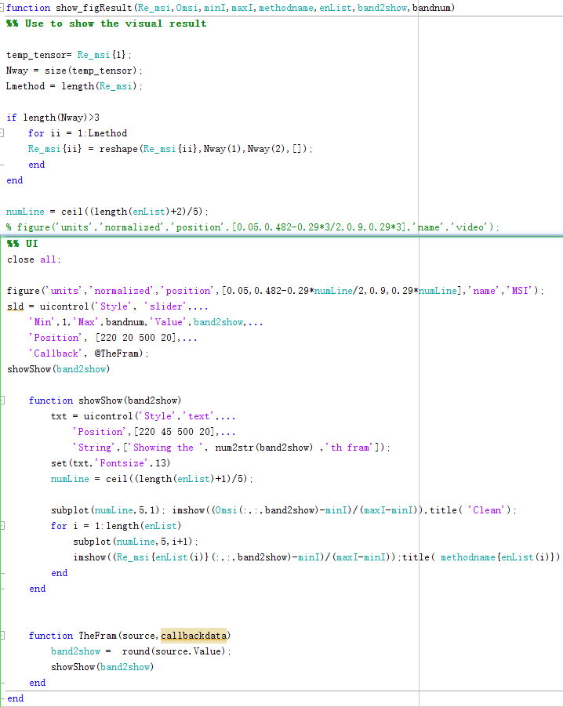
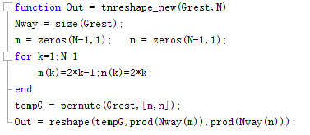
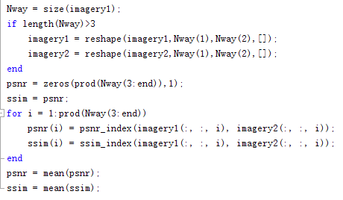
show_figResult.m
│ Demo_HSV.m
│ README.txt
├─data
│ HSV_test.mat
│
└─lib
│ show_figResult.m
│
├─inc_FCTN_TC
│ inc_FCTN_TC.m
│ inc_FCTN_TC_end.m
│ my_Fold.m
│ my_Unfold.m
│ tensor_contraction.m
│ tnprod_new.m
│ tnprod_rest.m
│ tnprod_rest_new.m
│ tnreshape_new.m
│
├─quality_assess
│ psnr_index.m
│ psnr_ybz.m
│ quality_ybz.m
│ ssim_index.m
│
└─tensor_toolbox
Contents.m
tenones.m
tenrand.m
tnorm.m
tt_cp_fg.m
Code
tnreshape_new.m
quality_ybz.m

Slide 27
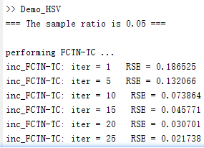
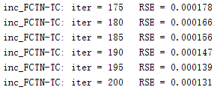
Code
…

Slide 28
Thanks
Yu Zhang 2021.04.05

Slide 29
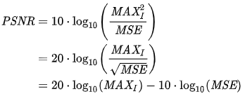
Supplementary material
Some notations
1. $G_{k}$(k = 1,2,…,N) is the k-th factor tensor.
2. $X_{[n_{1:d};n_{d+1:N}]}$ is defined as a matrix, which sastifies
.
3. $X_{(k)}$ is the traditional mode-k unfolding.
4. $X^{(s)}$ indicates the new $X$ after $s$ iterations.
5. $𝒢_{k}^{s+1}=GenFold({\left(G_{k}^{\left(s+1\right)}\right)}_{\left(k\right)},k;1,…,k−1,k+1,…,N)$ indicates the new $X$ after $s$ iterations.
6. $R_{k_{1}, k_{2}}$ are the FCTN-ranks
7. $PSNR$
8. MSE

Slide 30
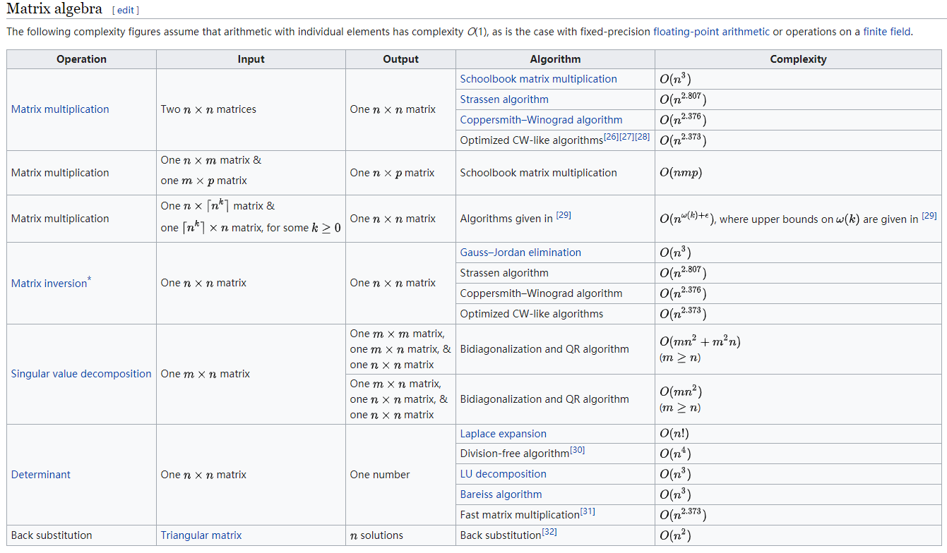
Supplementary material
Matrix operation complexity

